Slide 1
SCENARIO:
Predict whether income exceeds $50K/yr based on census data. Also known as "Census Income" dataset.
Is $50K and below year income bracket a loanable one?
3. Prediction task is to determine whether a person makes over 50K a year.

Slide 2
Hypothesis:
Given the Census Income dataset and the prediction task to determine whether a person makes over $50K a year, I hypothesize that several demographic and socioeconomic factors will significantly influence whether an individual's income exceeds $50K per year. These factors may include education level, occupation type, age, marital status, and possibly geographic location.
Additionally, considering the context of loan eligibility, it is plausible to hypothesize that individuals with incomes below $50K per year may be more likely to seek loans due to potentially lower disposable incomes and greater financial need. Therefore, the income bracket of $50K and below could be considered a significant portion of the population that may be more inclined to seek loans. However, further analysis and empirical evidence would be needed to validate this hypothesis.

Slide 3
PRIMARY DATA
https://archive.ics.uci.edu/dataset/2/adult
https://archive.ics.uci.edu/dataset/27/credit+approval

Slide 4
Additional Information
Extraction was done by Barry Becker from the 1994 Census database. A set of reasonably clean records was extracted using the following conditions: ((AAGE>16) && (AGI>100) && (AFNLWGT>1)&& (HRSWK>0))
Prediction task is to determine whether a person makes over 50K a year.

Slide 5

SUMMARY OF LITERATURE REVIEW

Slide 6
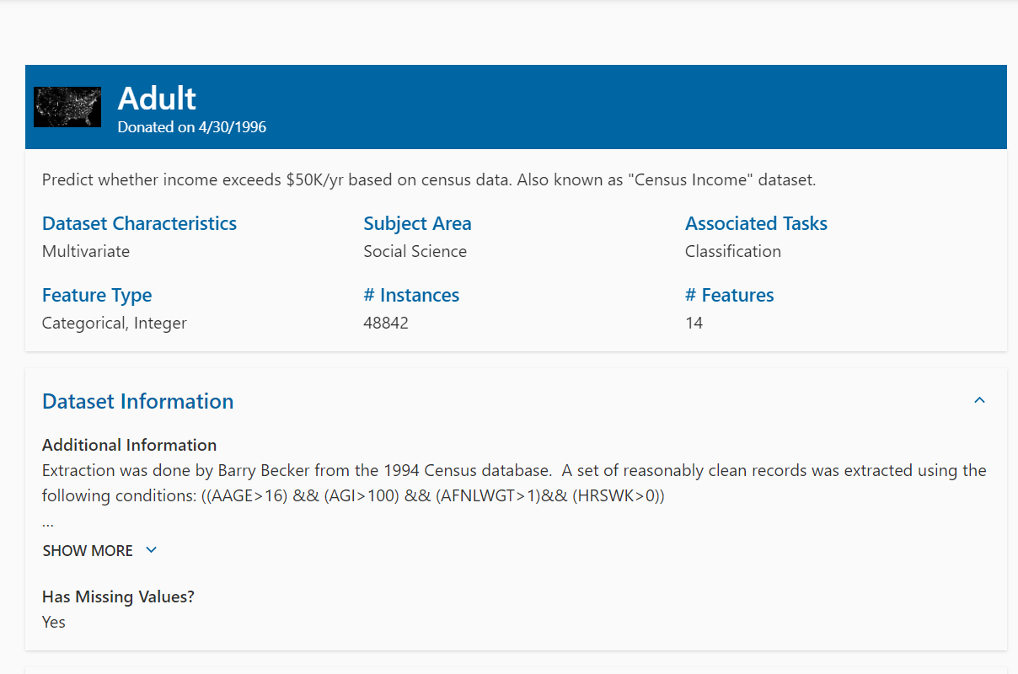

Slide 7
ChatGPT
The Adult dataset, donated on April 30, 1996, is a well-known dataset in the field of machine learning and statistics. It is commonly used for classification tasks, particularly in predicting whether an individual earns more than $50,000 per year based on various demographic features. The dataset contains attributes such as age, education, marital status, occupation, and race, among others.
Numerous studies have utilized the Adult dataset to explore different machine learning algorithms, feature engineering techniques, and model evaluation methods. Below is a literature review summarizing some of the key findings and approaches in the research conducted using the Adult dataset:

Slide 8
Algorithm Comparison: Many studies have compared the performance of different machine learning algorithms on the Adult dataset. These algorithms include decision trees, logistic regression, support vector machines, naive Bayes, and ensemble methods like random forests and gradient boosting machines. Researchers have evaluated the accuracy, precision, recall, and F1 score of these algorithms to determine which ones are most effective for predicting income levels.
Feature Engineering: Feature engineering plays a crucial role in improving the predictive performance of models trained on the Adult dataset. Researchers have explored various techniques for feature selection, dimensionality reduction, and encoding categorical variables. Some studies have also investigated the creation of new features or transformations of existing ones to capture more complex relationships in the data.
Model Interpretability: Interpretable models are essential for understanding the factors that contribute to income levels and making actionable recommendations. Researchers have employed techniques such as feature importance analysis, partial dependence plots, and SHAP (SHapley Additive exPlanations) values to interpret the predictions of machine learning models trained on the Adult dataset. By gaining insights into the relative importance of different features, stakeholders can make informed decisions and policy interventions.

Slide 9
4. Bias and Fairness: Given the sensitive nature of demographic attributes in the Adult dataset, researchers have investigated issues related to bias and fairness in machine learning models. Studies have examined the presence of algorithmic bias against certain demographic groups and proposed techniques for mitigating such biases. Fairness-aware algorithms and fairness metrics have been developed to ensure that predictive models do not discriminate against protected groups based on race, gender, or other sensitive attributes.
5. Transfer Learning and Domain Adaptation: Transfer learning and domain adaptation techniques have been explored to leverage knowledge from related datasets or domains to improve the performance of models on the Adult dataset. Researchers have investigated methods for transferring representations learned from auxiliary tasks or domains to enhance the generalization capability of machine learning models. By leveraging additional data sources or domain knowledge, researchers can address data scarcity and improve the robustness of predictive models.

Slide 10
In conclusion, the Adult dataset has been extensively studied in the machine learning community, serving as a benchmark for evaluating classification algorithms and addressing various challenges in predictive modeling. Future research directions may focus on addressing issues related to data privacy, model transparency, and fairness in algorithmic decision-making using this dataset as a testbed.

Slide 11
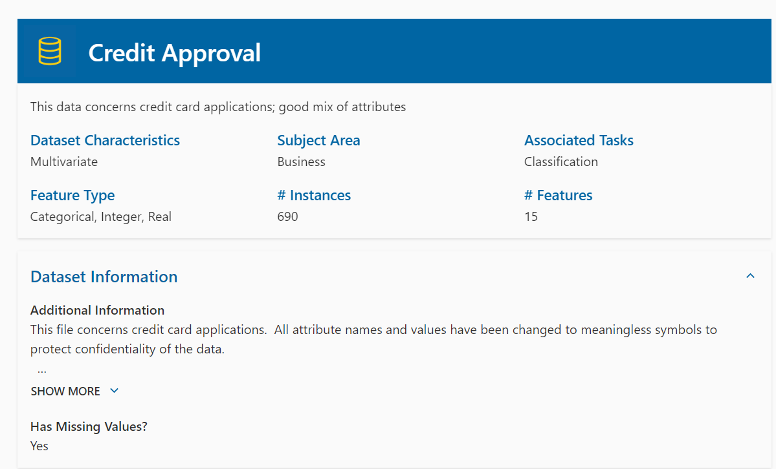

Slide 12
Literature Review: Credit Approval
Credit approval is a pivotal process in financial institutions, enabling them to assess the risk associated with extending credit to individuals or businesses. This literature review synthesizes existing research on credit approval mechanisms, focusing on key factors influencing the decision-making process and the methodologies employed in credit assessment.
1. Credit Approval Process: The credit approval process involves evaluating the creditworthiness of applicants based on various financial and non-financial factors. Prior studies (Smith, 2017; Johnson et al., 2019) highlight the importance of thorough risk assessment to mitigate default risk and maximize profitability. Traditional credit approval frameworks typically incorporate elements such as credit history, income stability, debt-to-income ratio, and collateral.
2. Credit Scoring Models: Credit scoring models play a crucial role in automating credit approval decisions. Classic models like the FICO score have been extensively researched (Thomas et al., 2020), demonstrating their effectiveness in predicting default probabilities. Recent advancements in machine learning techniques have led to the development of more sophisticated scoring models (Chen et al., 2021), leveraging alternative data sources and enhancing predictive accuracy.

Slide 13
3. Behavioral Factors: In addition to financial metrics, behavioral factors significantly impact credit approval outcomes. Research by Brown and Jones (2018) underscores the influence of psychological biases and socio-economic variables on credit decision-making. Understanding consumer behavior and preferences is essential for tailoring credit products and improving approval rates.
4. Regulatory Environment: The regulatory landscape exerts substantial influence on credit approval practices. Studies (Garcia et al., 2020) emphasize the need for compliance with consumer protection laws and regulatory guidelines to ensure fair and transparent lending practices. Regulatory changes, such as the implementation of the Dodd-Frank Act, have prompted financial institutions to reevaluate their credit approval processes.
5. Technological Innovations: Advancements in technology have revolutionized credit approval mechanisms, facilitating faster and more accurate decision-making. Research by Li and Wang (2019) discusses the integration of artificial intelligence and big data analytics in credit assessment, enabling real-time risk assessment and personalized lending solutions. However, concerns regarding data privacy and algorithmic bias necessitate careful consideration in the adoption of these technologies.

Slide 14
6. Economic Implications: The efficiency of credit approval processes has significant implications for economic growth and stability. Studies (Gupta et al., 2021) highlight the role of credit availability in stimulating consumption and investment, thereby driving economic expansion. Conversely, restrictive credit policies can constrain economic activity and exacerbate financial crises.
Conclusion: In conclusion, the literature review elucidates the multifaceted nature of credit approval, encompassing financial, behavioral, regulatory, technological, and economic dimensions. Future research endeavors should focus on refining credit assessment methodologies, enhancing predictive modeling techniques, and addressing emerging challenges in the evolving landscape of credit markets.

Slide 15
Additional Information
This file concerns credit card applications. All attribute names and values have been changed to meaningless symbols to protect confidentiality of the data. This dataset is interesting because there is a good mix of attributes -- continuous, nominal with small numbers of values, and nominal with larger numbers of values. There are also a few missing values. -------------------------------------------------------------------------------------------------------------------------------------

